Slide 1



GUI CONTROLLED TIME SEREIS FORECASTING
ASHIKH KADAVATH
ARUN THAVRAMKUNNATH ASHOKAN PROF. DR. JURGEN WITTMANN
MUHAMMED IBRAHIM
RAHUL PLANTHOTTATHUKUNNEL GIRIJAN

Slide 2
CONTENT
INTRODUCTION
PROJECT UPDATE
CONCEPT
DATASET
CODE STRUCTURE
TIME SERIES MODEL
TKINTER
ARCHITECTURE DIAGRAM
PROPOSED SYSTEM
SCOPE AND APPLICATION
RISKS AND LIMITATIONS
TIMELINE

Slide 3
INTRODUCTION
Tool used for informing the users about the expected weather conditions.
Can be used to plan our day to day activities to make our daily decisions and may even help keep us out of danger.

Slide 4
PROJECT UPDATE
Literature Research ✓
Define execution ✓
Model building ✓

Slide 5
CONCEPT
ARIMA MODEL:
  To predict the future Weather of a particular city using python
  Collect the data sets from previous weather data of the city
  Make nonstationary data sets into the stationary data sets
  Decide the ARIMA model
  Test and train the Data sets
  Check your Accuracy Metric

Slide 6
Concept
GUI:
  Installing the required libraries using the pip package manager
  An input component which defines the type of the input (file, textbox, image upload, etc.)
  An output component defines the type of output (file, textbox, label, audio, etc.)
  The callable function: the primary inference function applied to the input and rendered in the output. That function could be anything from a simple print to a pre-trained model
  The launch() function is responsible for running the application

Slide 7




DATASET
4 Years + Dataset collected.
RELATIVE
HUMIDITY
TEMPERATURE
WIND SPEED
PRECIPITATION

Slide 8
CODE STRUCTURE
Model Training and Execution
Importing Libraries-->Reading collected data--> Checking for stationarity-- >Executing the Arima Model -->Auto Regression, Integrated, Moving Average-->Splitting the Data Set for Training and Testing--> --> train the model -- >evaluate model--> Save the model

Slide 9
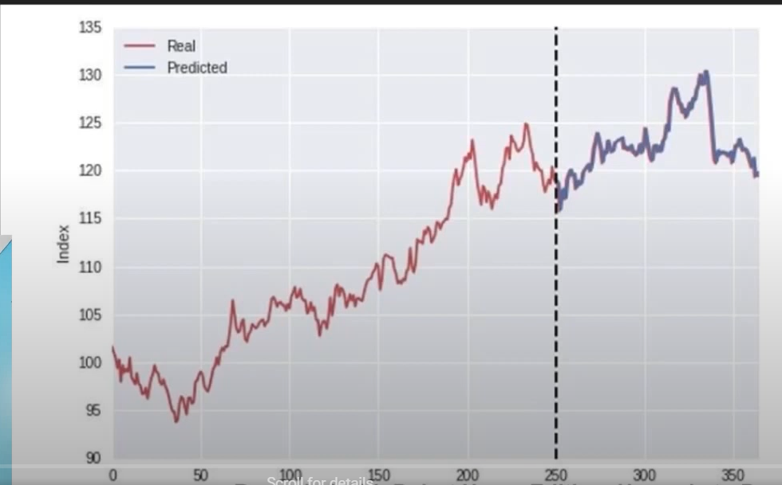
TIME SERIES MODEL

Slide 10
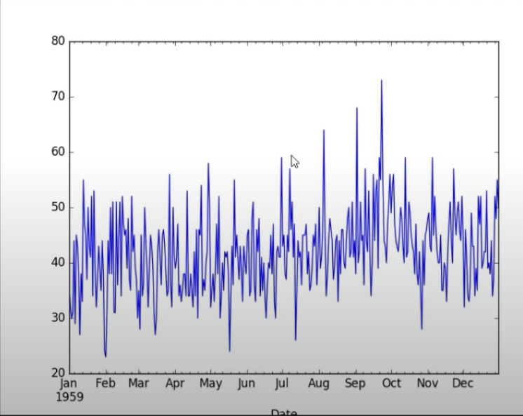
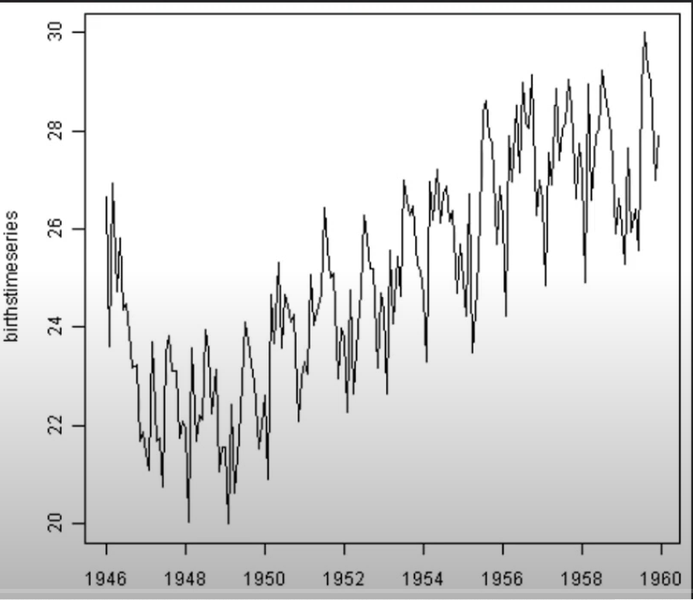
Time series model
Stationary
Non Stationary

Slide 11

tkinter
Tkinter is the standard Python interface to the GUI toolkit, and is included with Linux, Microsoft Windows and Mac OS X. The widgets available in Tkinter library are as follows:-
Containers- frame, top level, paned window.
Buttons- button, radio button, check button, menu button.
Text widget- label, label frame, massage, text.
Entry widgets- scale, scroll, list box, slider, spin box, entry(single line), text(multiline), and canvas(vector and pixel graphics).

Slide 12
ARCHITECTURE DIAGRAM
User Device
Enter the Date
Front End
Sending Response back to user
Request for weather forecast
Open weather- ARIMA Model
Back End
Current weather
Weather Forecast

Slide 13
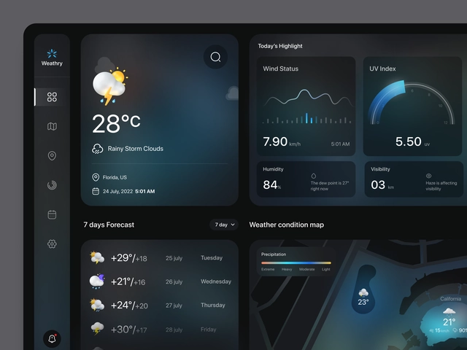
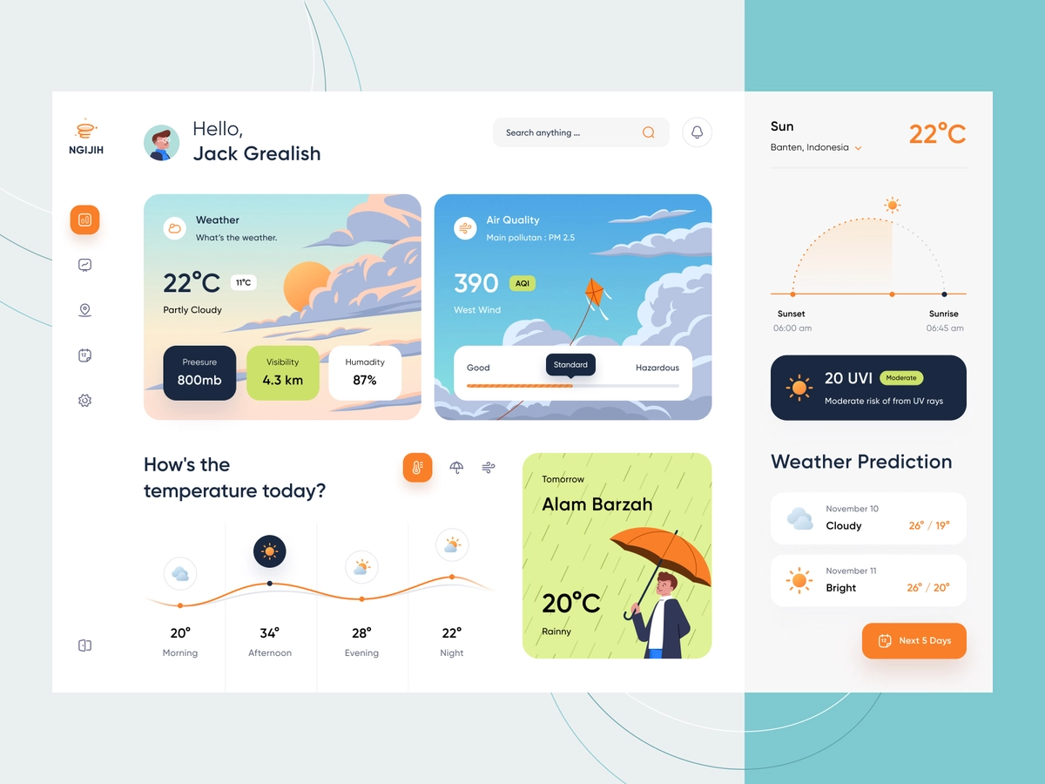
Proposed system

Slide 14
Scope and application
To predict large scale patterns and transitions in advance one month.
For planting and harvesting their crops, farmers need information to help them plan.
In order schedule flight, airlines needs the local weather conditions.
With the use of rich icons user experience can be further enhanced. For instance, sun icon for sunny day, moon can show nighttime, clouds indicate foggy weather.

Slide 15
RISKS AND LIMITATIONS
Poorer performance for long term forecasts.
Cannot be used for seasonal time series.
Difficult to predict turning points.

Slide 16
TIMELINE
Sorting and methodology selection
First Presentation
Working model
Final report submission
27/11/2022
03/11/2022
10/112022
17/11/2022
24/11/2022
08/12/2022
22/12/2022
25/01/2023
Literature search
Data collection
Presentation Status
Final Presentation

Slide 17
REFERENCE
Ayush Agrawal, Qureshi M F(2014), “Indian Weather Forecasting using ANFIS and ARIMA based Interval Type-2 Fuzzy Logic Model”
Nikita Shivhare, S.B. Dwivedi, Prabhat kumar sigh Dikshit(2019), “ARIMA based daily weather forecasting tool: A case study for Varanasi”
L. Antonio Vélez‐Espino, Ethan Clemons(2019), “ForecastR: tools to automate forecasting procedures for salmonid terminal run and escapement”
Mahmudur Rahman, A.H.M. Saiful Islam , Shah Yaser Maqnoon Nadvi, Rashedur M Rahman(2013), ”Comparative Study of ANFIS and ARIMA Model for Weather Forecasting in Dhaka”

Slide 18


